Slide 1

Performance Optimisation
‘The more you sweat in peace
the less you bleed in war’
Notes:
Reference the above quote.

Slide 2
What is Stress Inoculation Training
(SIT)?

Slide 3
Who needs it?

Slide 4
The Stress Response

Slide 5
Stress Response
It’s not all bad !
What is a normal response ?
  What are it’s beneficial effects ?
Notes:
Group Discussion on the above topics will help you glean where your learners knowledge is at for this topic and quite useful at this stage.

Slide 6
BUT excessive stress response can…
Impair your ability to
  Think
  Make decisions
  Plan
  Do tasks
    Cannulation
Affect patient and physician wellbeing

Slide 7
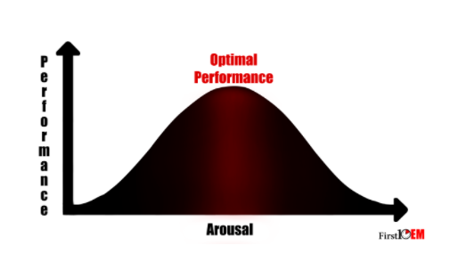
Notes:
https://first10em.com/2017/03/13/performance-under-pressure/

Slide 8
Threat
Vs
Challenge

Slide 9
Threat versus challenge
What is a Challenge ?
  Where resources > demand.
    Facilitates high performance
What is a Threat
  Demand > resources
    Threatens our performance
Notes:
Group Discussion
What does a Challenge shift look like?
Emergency staff will recognise this– it’s the ideal day at work. The day flies by, we’ve had a busy but manageable day at work and leave our departments tired but happy/exhilarated.
What does a Threat shift look like?
Emergency Staff will also know this one – the days we are under staffed, overcrowded and seem to have every sick patient in the State appear in one shift! We finish the day exhausted, disgruntled and unable to find satisfaction in any of the work we have achieved.
But what does ‘Demand’ on the clinician actually look like?
Excessive patient load
Poor Departmental design
High levels of bed block
Low staffing levels

Slide 10
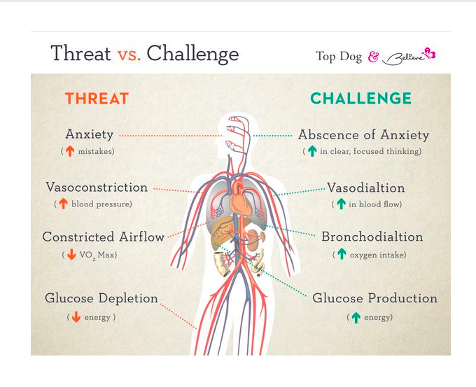
Notes:
Picture reference - https://www.believeiam.com/blogs/biablog/8136259-the-science-of-winning-how-to-become-the-top-dog-now,
But why does this even matter?
No-one is suggesting that we just accept the second shift as the reality of our job.
Of course, it would be wonderful if we could fix the system, but by developing strategies to optimise our ability to work in the challenged state, we better prepare ourselves to perform effectively at times of heightened stress.
This allows us to perform temporarily in the heightened state, then recover and return to the challenged state when the threat has passed.

Slide 11
Prevention is better than Cure
Stop the challenge ever becoming a threat
Optimise resources
  Minimize threats
But you do become psychologically threatened….
  Be able to manage that too

Slide 12
So if prevention is better than cure what strategies are there….
Notes:
Discussion Slide
Find out here what your techniques your learners use to help them cope and thrive?
Also explore what they have found doesn’t work !

Slide 13
Prevention Strategy 1
Consider HALTS

Slide 14
Ask yourself - Am I HALTS ?
HALTS
  Hungry
  Angry
  Late
  Tired
  Stressed
Notes:
Discussion
The function of this activity is to get to learner to focus on increasing self awareness without actually calling it that!

Slide 15
Prevention Strategy 2
Use your breath

Slide 16
Square Breathing
Notes:
Discussion
This is to activate the para-sympathetic nervous system.
At this stage , if as a facilitator you know there are a few skeptics in the room, it may be wise to outline the science and the physiology behind this again.
Also ask everyone to do this task with their eyes closed. Also be sure to offer to the learners that you will close your eyes too.
This may limit the possible discomfort of the learners in the room.
I normally show them one round and then do 4 more with the group in sync with me.

Slide 17
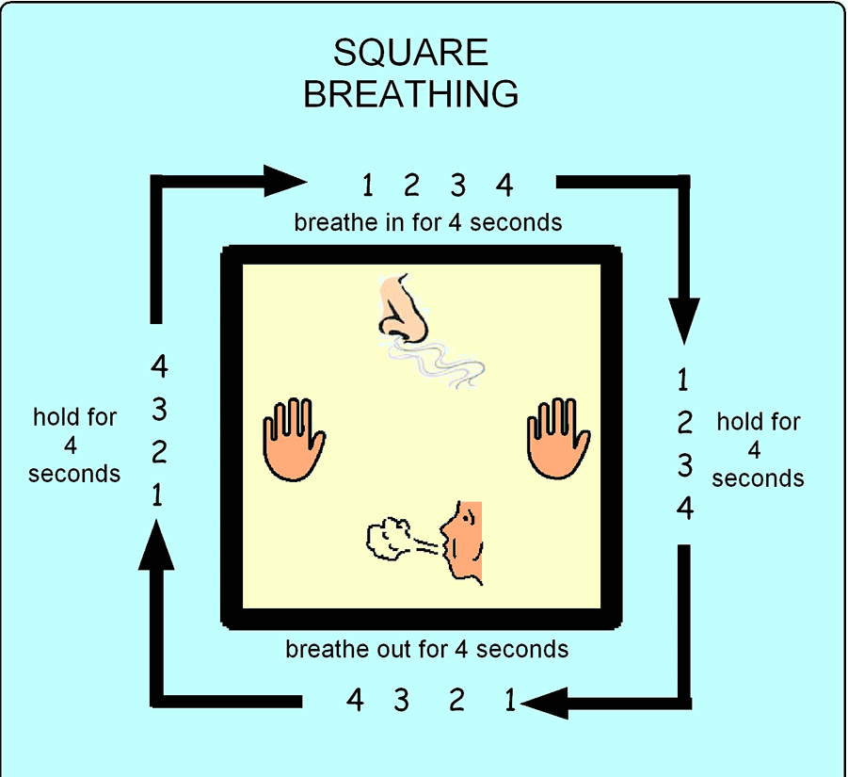
http://visuals.autism.net/main.php?g2_itemId=138
Notes:
http://visuals.autism.net/main.php?g2_itemId=138

Slide 18
Prevention Strategy 3
Practice as a Team
Notes:
Discussion
What do you do in your department to help you practice as a team – maybe simulation, maybe the team briefing at the start of a resus shift.
If you don’t have any of the above in your department, ask your learners to suggest how they ‘could’ practice as. Team given the opportuinity

Slide 19
Practice as a Team
Simulation
  Insitu
  In Sim lab
Model for Resus Prep at the start of your shift
  What do we know
  What do we expect
  What will we do
  What are our roles
Notes:
This may also help increase Buy In if you have an established Simulation Programme in your Department.

Slide 20
Strategy 4
Optimize your thinking

Slide 21
Optimise your thinking
Cognitive reframing
  Consider task chunking
  Focus on your successes, not failures
    Last 50 I got right
      Not the last 2, I got wrong
AVOID perfection bashing
  Do what’s Acceptable
  Do what’s Necessary
    Perfection is the enemy of good – Voltaire/Dr. Victoria Brazil

Slide 22
Strategy 5
Use mental rehearsal – ‘Visualization’
OPTIONAL
Notes:
This is optional and only should be done if you have sufficient time – it takes about 20 minute to explain and do it justice

Slide 23
Why might visualization work for performance optimization ?
Notes:
Mentally rehearse how you would perform a difficult procedure like a surgical airway.
By running through the steps in your head, you will perform better when you come to do the task under pressure.
By just running through the process to the actual time it takes and keeping the details real to your situation, the brain can actually adapt to the activity without physically performing it.

Slide 24
Visualization
KEEEP AN OPEN MIND…………….
One suggested model is PETTLEP
Pick a task that makes you somewhat uncomfortable
Everyone is different for what their weakness/Kryponite is
  Conflict
  Procedure
  Exam
Notes:
WRaP Team tips about using Visualisation for Facilitator
Ensure you fully understand this as a concept before you educate on this section
Practice it yourself so you can give a short and succinct example on the day – 3 min version perhaps
Anticipate that there will be some skeptics in the room
Ensure you have enough time in your session- this section takes least 10 minutes by the time you have offered an example and they have gone through it once themselves.

Slide 25
PETTLEP
Physical
  Clothes, stance
Environment
  Similar environment
Task
  Each task being performed at the skill level of the person doing the task
Timing
  Same time frame to complete the task
Learning
  Evolve the process over time
Emotion
  Noise - beeping of a monitor. Can use sim man for this if required
Perspective
  Either doing it your self to looking at yourself doing it

Slide 26
Performing Optimization
During a Stressful Stimulus

Slide 27
Performing Optimization
During a Stressful Stimulus
Use cognitive off loading
Avoid Multitasking if possible
Use your self awareness
  Am I HALTS?
  Do I need the bathroom ?
Notes:
Use cognitive off loading
ACLS algorythm
Activate Trauma systems
Use shared mental model
Re Cap
Ask the team if you have missed anything?
Use your self awareness
Am I HALTS?
Ask a colleague to grab you a snack esp during a long Resus
Have a snack while waiting for the Ambulance to arrive
Do I need the bathroom ?
Once you get a moment go to the loo!

Slide 28
Performance Optimization
After the Stressful Stimulus
Create the Mental Gap between Work and Home
Be grateful
Reflect
Debrief
Notes:
Mental Gap Creation
Efficiency is key.
Techniques which may help include
Prolonged mindful hand wash before leaving work
Square breathing when you sit into your car or the bus home
Journaling for 10 mins before you leave work,
Consider the concept of The Third Space as outlined by Adam Fraser
Be grateful
To your team
Your family
The man at the check-out counter in the shops on your way home from work.
Reflect
Please see WRaP topic on Reflection for more info
Do it with structure
Do it frequently
With no judgement.

