Slide 1

Leadership & Professionalism
Developed by Shahina Braganza for WRaP EM

Slide 2
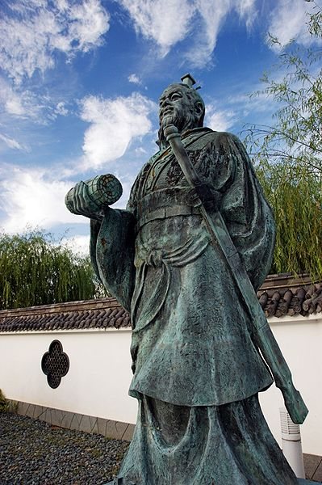
Sun Tzu – Chinese General – The Art of War
Leadership is a matter of intelligence, trustworthiness, humaneness, courage, and discipline ...
Reliance on intelligence alone results in rebelliousness.
Exercise of humaneness alone results in weakness.
Fixation on trust results in folly.
Dependence on the strength of courage results in violence.
Excessive discipline and sternness in command result in cruelty.
When one has all five virtues together, each appropriate to its function, then one can be a leader.
Notes:
Chinese general, military strategist, and philosopher who lived in the Spring and Autumn period of ancient China. Sun Tzu is traditionally credited as the author of The Art of War, a widely influential work of military strategy that has affected both Western and Eastern philosophy.
Image - https://commons.wikimedia.org/wiki/File:Enchoen27n3200.jpg#/media/File:Enchoen27n3200.jpg -
Permission is granted to copy, distribute and/or modify this document under the terms of the GNU Free Documentation License, Version 1.2 or any later version published by the Free Software Foundation; with no Invariant Sections, no Front-Cover Texts, and no Back-Cover Texts. A copy of the license is included in the section entitled GNU Free Documentation License.

Slide 3
Leader traits ➡ Leader behaviours
Notes:
It was traditionally assumed that leaders were born, not developed ie. that leadership is rooted in the characteristics of certain individuals. This idea that leadership is based on individual attributes is known as the "trait theory of leadership".
Subsequently, it has been recognised that leadership is not an enduring individual trait, as it was noted that individuals can be effective in some certain situations, but not others.
The focus then shifted away from traits of leaders to an investigation of the leader behaviours that were effective.

Slide 4
Do you consider yourself to be a leader?
Consider in what way(s) you display Leadership traits or behaviours in your work environment.

Slide 5
At the end of this module, you will be able to …
4. Understand the paradigm of leadership - The Doctor as Team Leader.
5. Identify potential barriers to leadership development and synthesise strategies to resolve (mitigate) them. Then potentiate your own leadership development in your workplace.
1. Understand and describe the differences between leadership and management.
2. Describe the relationship between leadership and management.
3. Describe various models of effective leadership in context: transformational; transactional; collaborative; phronetic.

Slide 6
Objective 1
1. Understand and describe the differences between leadership and management.
  Models of leadership
  The contexts in which each style can be optimally effective

Slide 7
Management vs Leadership
Managers
perform functions in organisations.
generally hold a formal title or role.
Concerned with planning, organising, coordinating, commanding or controlling the activities of staff,
thereby providing order and consistency
Tend to work within existing established paradigm., solve problems and manage people.
Focus on WHAT and HOW
Leaders
influence and guide others into pursuing particular objectives or vision of the future
motivate them into wanting to follow,
thereby producing change and movement.
Tend to create new paradigms, challenge systems, seek new opportunities and lead people.
Focus on WHY
Notes:
Note, however, that it is often the same person who operates in both capacities – the most effective people in organisations are both managers and leaders.

Slide 8
Objective 2
Describe the relationship between leadership and management.

Slide 9


Leadership Styles
Notes:
Different situations call for different leadership styles. In an emergency when there is little time to converge on an agreement and where a designated authority has significantly more experience or expertise than the rest of the team, an autocratic leadership style may be most effective; however, in a highly motivated and aligned team with a homogeneous level of expertise, a more democratic or Laissez-faire style may be more effective. The style adopted should be the one that most effectively achieves the objectives of the group while balancing the interests of its individual members.
Furthermore, the styles are not necessarily mutually exclusive or in competition with each other – there can be overlap.
As we outline these styles, think about the settings in which each may be most effective.
Image 1 - https://www.doctorsatsouthportpark.com.au/services/accident-and-emergency-services/
Image 2 - https://www.facultyfocus.com/articles/effective-teaching-strategies/making-the-most-of-reporting-out-after-group-work/

Slide 10
Objective 3
Describe various models of effective leadership in context: transformational; transactional; collaborative; phronetic.

Slide 11
Autocratic/Authoritarian
Leader holds all decision making power
Permits quick decision-making, as only one person decides for the whole group and keeps each decision to themselves until they feel it needs to be shared with the rest of the group.
Notes:
No suggestions or initiatives from subordinates.
What setting might this style be effective? Resus room – high end critical care decision making eg surgical airway, thoracotomy.

Slide 12
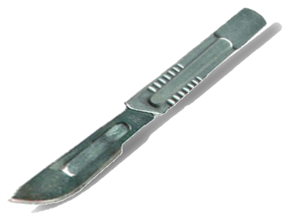
Autocratic/Authoritarian
Leader holds all decision making power
Permits quick decision-making, as only one person decides for the whole group and keeps each decision to themselves until they feel it needs to be shared with the rest of the group.
Notes:
No suggestions or initiatives from subordinates.
What setting might this style be effective? Resus room – high end critical care decision making eg surgical airway, thoracotomy.
Image - https://commons.wikimedia.org/wiki/File:Scalpel_small.png

Slide 13
Participative/Democratic
Leader shares the decision-making with group members by promoting the interests of the group members and by practicing social equality.
(Shared leadership)

Slide 14

Participative/Democratic
Leader shares the decision-making with group members by promoting the interests of the group members and by practicing social equality.
(Shared leadership)
Notes:
MDT meeting
Discussing investigation treatment options with patient/family
Image - https://www.nursingtimes.net/roles/practice-nurses/schwartz-rounds-adapted-for-smaller-health-providers/7000688.article

Slide 15
Task-oriented and relationship-oriented
Task-oriented leadership
leader is focused on the tasks that need to be performed in order to meet a certain production goal.
Task-oriented leaders are generally more concerned with producing a step-by-step solution for given problem or goal, strictly making sure these deadlines are met, results and reaching target outcomes.
Relationship-oriented leadership
leader is more focused on the relationships amongst the group and is generally more concerned with the overall well-being and satisfaction of group members.
Relationship-oriented leaders emphasize communication within the group, show trust and confidence in group members, and show appreciation for work done.
Notes:
This is somewhat related to Transactional and Transformative Leadership respectively…
I have a story of when I became DCT and focused on the latter, arguably at the cost of the former

Slide 16
Transactional leadership

Slide 17
Transformational relationship

Slide 18
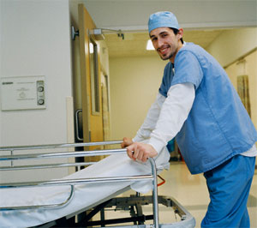
Power and influence
Consider the power of the people in your workplace who might not hold rank, but who strongly influence the tone of their environment.
Notes:
Wardies, Aos
Image - https://schools.look4.net.nz/careers/new-zealand-careers/careers-descriptions/health-administration-and-support-careers/hospital-orderly

Slide 19
Emotional intelligence

Slide 20
Objective 4
Understand the paradigm of leadership - Recognise an ability to manifest leadership at all levels within a hierarchy - ‘The Doctor as Team Leader’.

Slide 21
Objective 5
Identify potential barriers to leadership development and synthesise strategies to resolve(mitigate) them. Then potentiate your own leadership development in their workplace.

Slide 22
Developing leadership

Slide 23
Leadership journey pathway

Slide 24
Myths about leadership

Slide 25
What do you perceive to be your barriers to Leadership?
PERSONAL
ORGANISATIONAL/CULTURAL
COMPETING AGENDAS
WIDER AGENDA
Notes:
Think about strategies/approaches to addressing these barriers/challenges.

Slide 26
Reflection
What is one thing you are going to try to do differently (or more thoughtfully) next shift in order to manifest Leadership?

