Slide 1

Positive Psychology in the ED
Bethany Boulton Staff Specialist EM

Slide 2
By the end of today….
Describe the dimensions and scope of PP
Explain Seligman’s PERMA model
Explain the role of positive emotions in psychological wellbeing and health
Identify and explain your character strengths

Slide 3
Preparation
VIA Character Strengths survey
Notes:
Pre-prepared activity

Slide 4
Confidentiality agreement

Slide 5

What is Positive Psychology

Slide 6
Why Positive Psychology?
Part of a self care program
Improve resilience
Decreased burnout

Slide 7
PERMA Model
Positive Emotion
Engagement
Relationships
Meaning
Accomplishment

Slide 8

Positive emotion

Slide 9
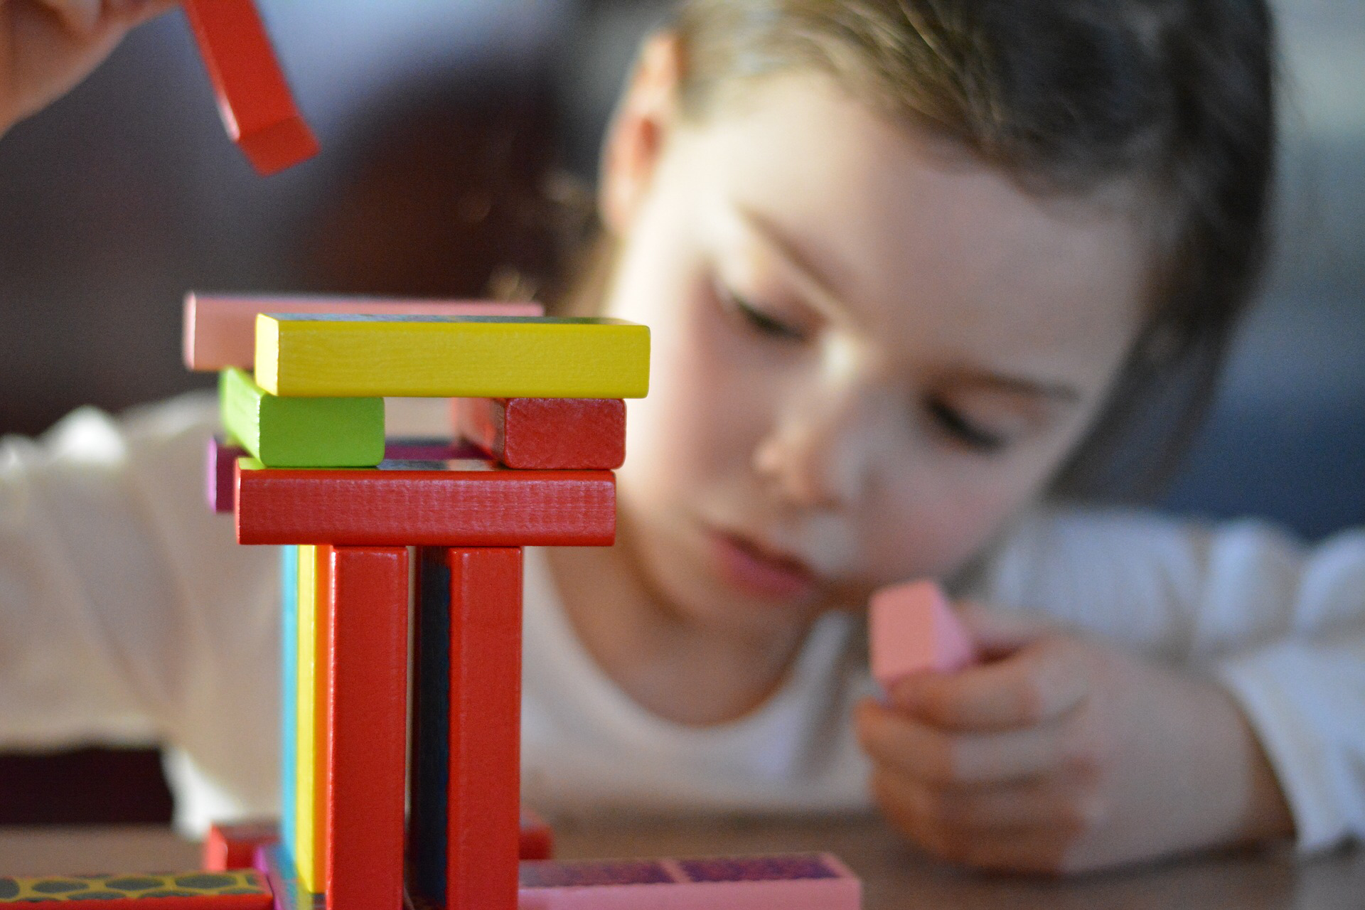
Engagement

Slide 10

Relationships

Slide 11
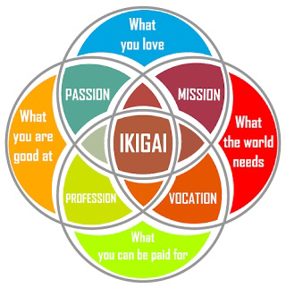
Meaning

Slide 12

Accomplishment

Slide 13
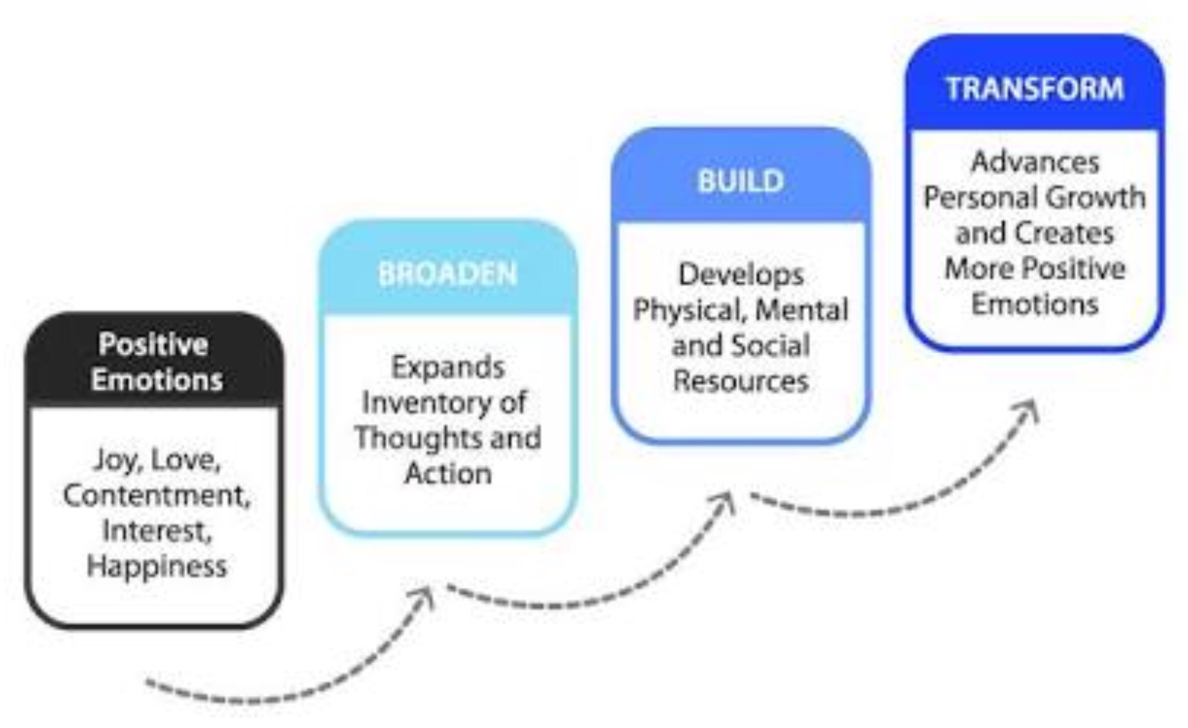
Broaden & Build Theory

Slide 14
Positive Emotions & Health
Joy
Gratitude
Serenity
Interest
Hope
Pride
Amusement
Inspiration
Awe
Love

Slide 15
Positive Emotions & Health
Positive immune effects
Reduced CV disease
Longevity
Psychological health

Slide 16
The evidence
Isen – An Influence of Positive Affect on Decision Making in Complex Situation: Theoretical Issues With Practical Implications
Cohen – Positive emotional style predicts resistance to illness after experimental exposure to rhinovirus or influenza a virus
Danner – Positive Emotions in Early Life and Longevity

Slide 17
Virtues
Wisdom
Courage
Humanity
Justice
Temperance
Transcendence

Slide 18
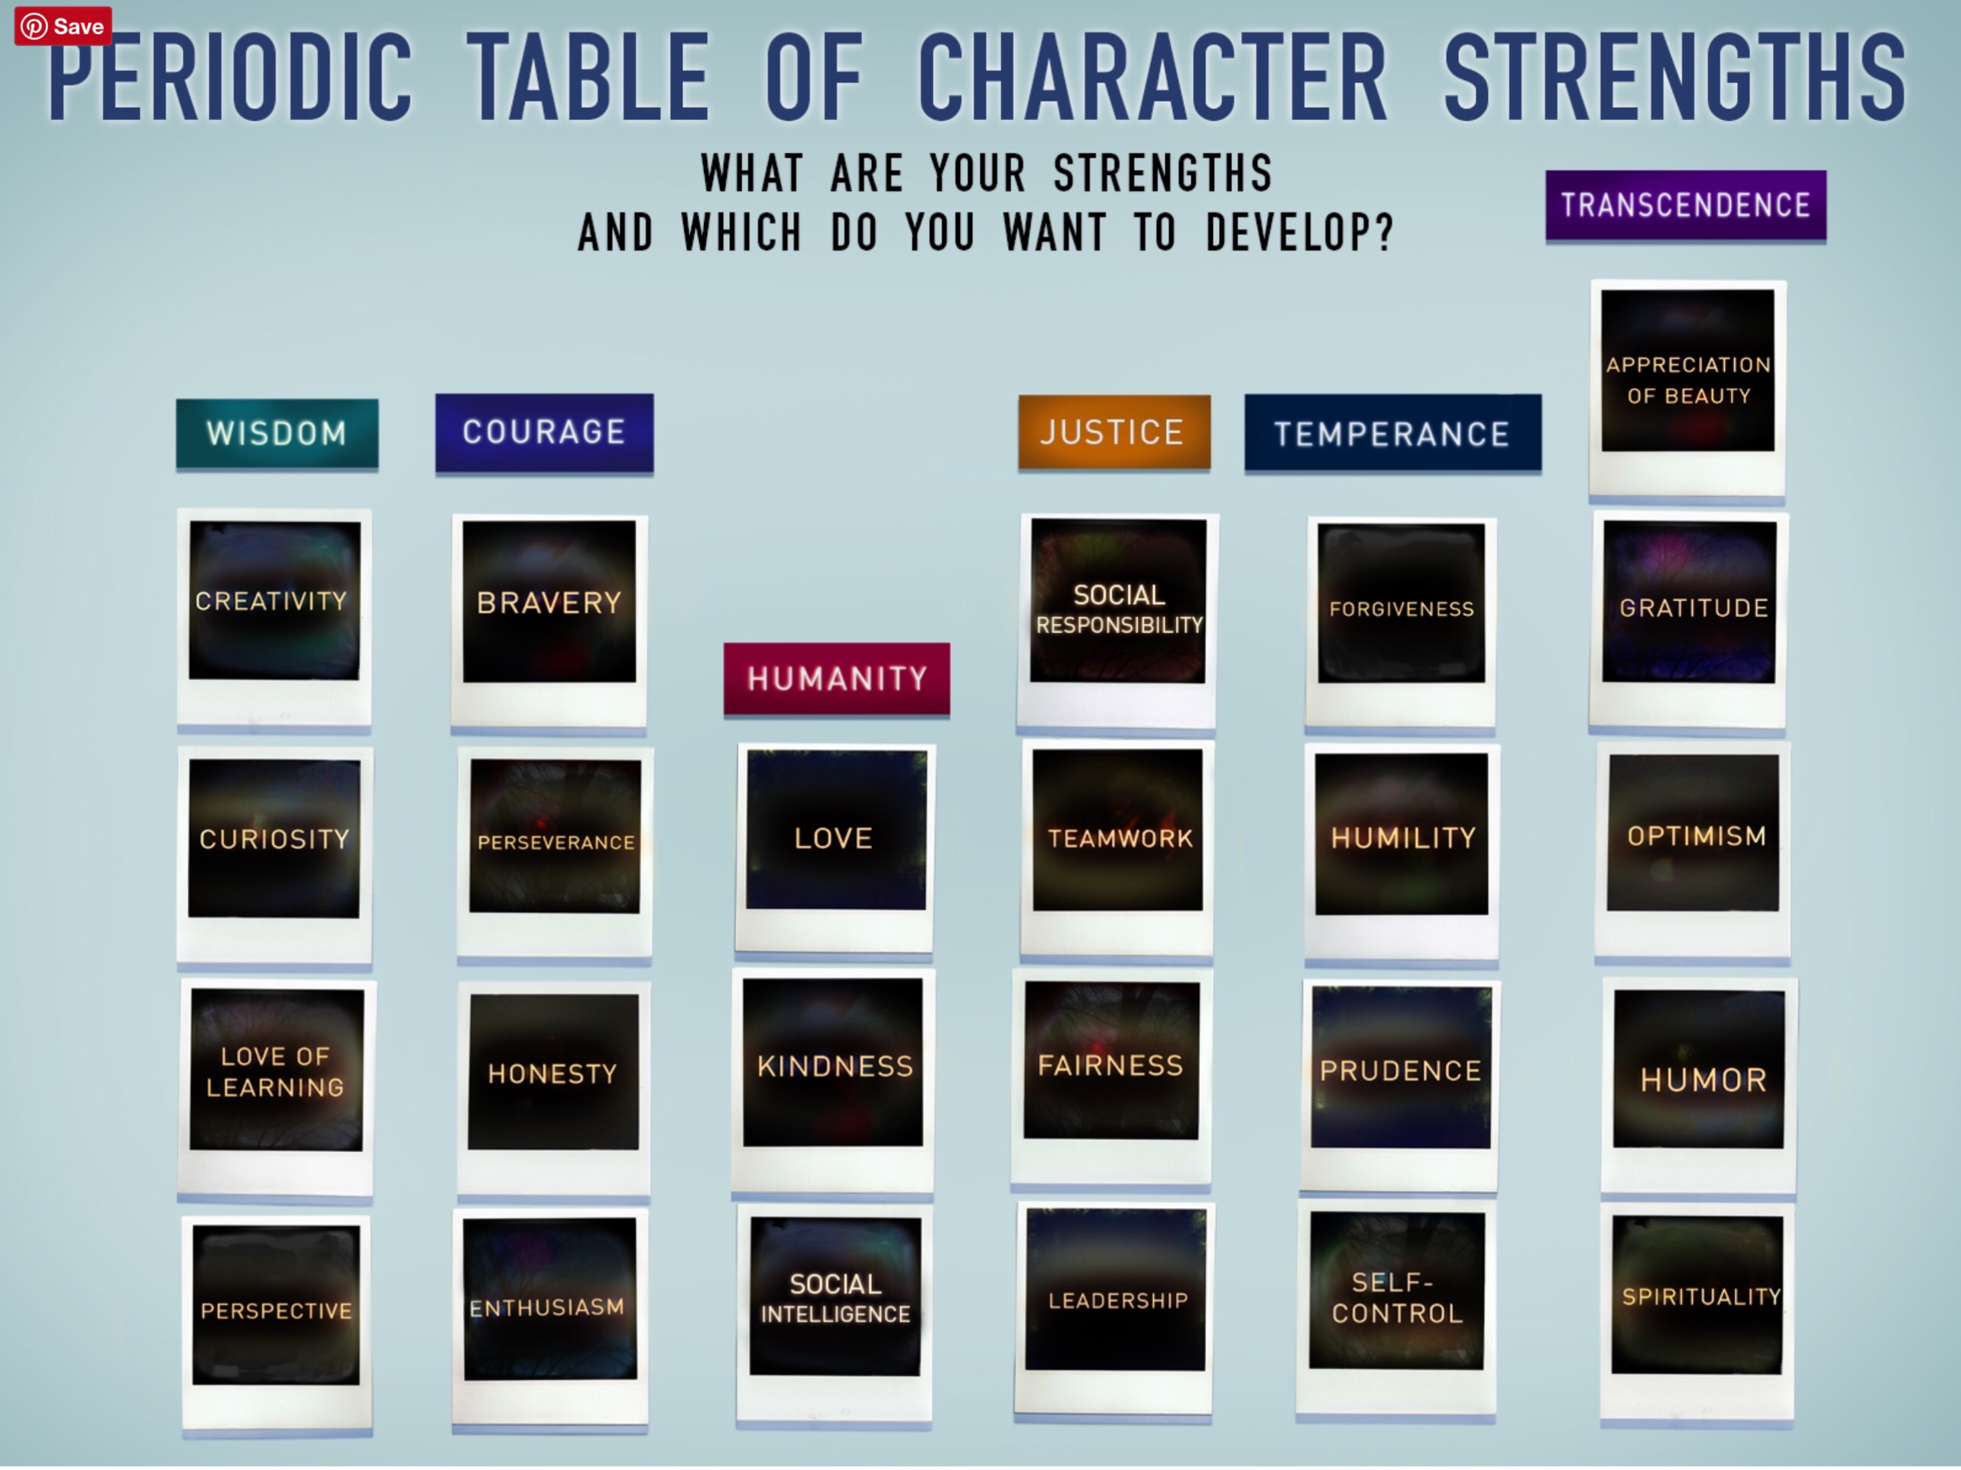

Slide 19
Activity
Top 5 character strengths?
How can you apply these at work?
Your life?
Notes:
On the VIA character strengths survey, what are your top 5 character strengths
How did your strengths play a part in your STAR response?
How do you think these character strengths have played a part in your life?

Slide 20
Application
Seligman – Positive Psychology Progress Empirical Validation of Interventions
What went well
Three Blessings
Gratitude Visit

Slide 21
Challenge
Use your signature strength
Gratitude visit
Three Blessings
What went well

