Slide 1
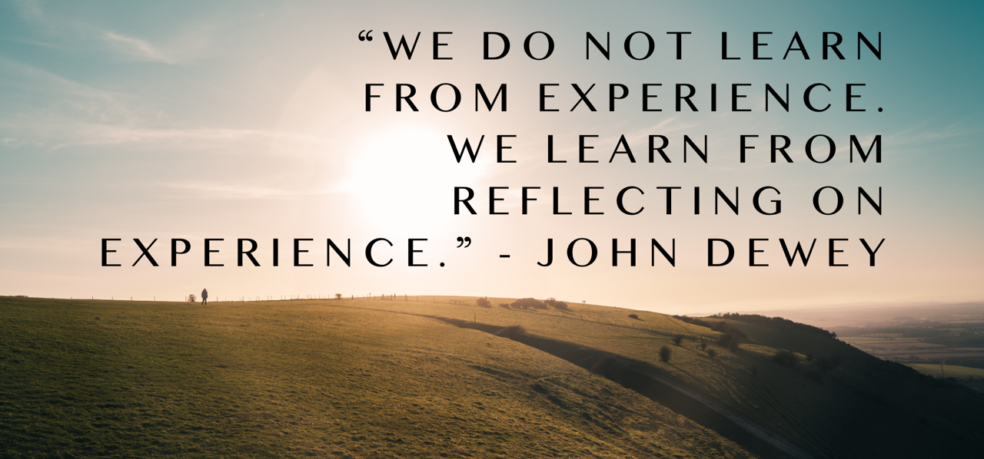

Reflection
Notes:
Reflective practice is more than just looking back at the events in the past.
It is a way to be more intentional in the future. It is the ability to reflect on your actions in a process of ongoing learning.
Having the ability to reflect on your actions is a really important tool for ongoing learning and for processing our experiences.

Slide 2
Reflection
What is it?
Why do it?

Slide 3

Notes:
Reference for picture https://pixabay.com/en/fox-wild-nature-water-mirror-1540833/
Discussion prompt
What is reflection?
Think carefully or deeply
Seek understanding of self or situation to inform future actions
Why do it?
Strengths and weaknesses
Acknowledge fears
Identify underling values and beliefs
Identify areas for improvement

Slide 4
Reflection in the ED
Why do it in ED?
  Make sense of it all
  Process difficult events/situations
  Thrive not just survive in the messiness of it all

Slide 5
What is the ACEM requirement for you?
Notes:
Applies to ACEM trainees only. There may also be a requirement for accreditation for you individual college/regulatory body. Have a look online or contact them to see.

Slide 6
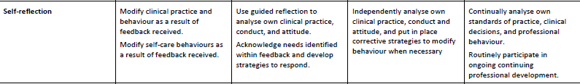

Slide 7
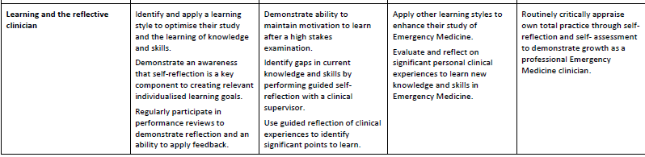

Slide 8
What are the barriers to reflection?

Slide 9

Notes:
Discussion points
What are the barriers to reflective practice
It takes time
It takes effort
It takes some training
to do well
It requires a change of pace
It requires self assessment
Accuracy of recall
Picture Reference - https://pixabay.com/en/girl-sitting-barrier-female-woman-1280690/

Slide 10

The Barriers
Time
Vulnerability
Fear of process
Fear of uncovering emotions
  Anger
  Sadness
  Vulnerability
  Helplessness
Don’t know how (never been shown how)
Don’t perceive benefits

Slide 11
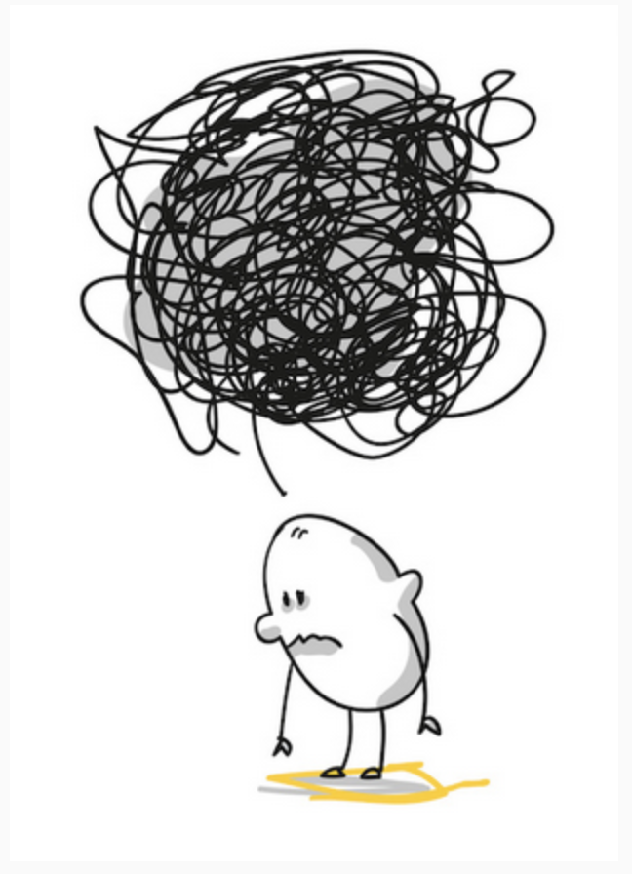
Reflection versus Rumination
Is there a difference?
Reflection is to think carefully, especially about possibilities and options.
Rumination refers to the tendency to repetitively think about the causes, situational factors, and consequences of one’s negative emotional experiences.

Slide 12

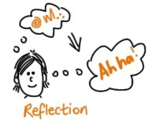
Reflection versus Rumination
Thinking about the “What is”
Think carefully or deeply & consider
Thinking about something with the intent of learning about it
Past can’t be changed, but can work towards a better future
Thinking about the “What ifs”
To go over in the mind repeatedly
Thinking about something over and over with negative emotions linked to it (regret, shame)
Generally following an adverse event

Slide 13

Reflective Practice is important for:
Aiding our understanding of self
Learning new skills
Building capacity to respond in challenging situations
Making better decisions
Managing your emotions
Developing resilience
Identifying and questioning underlying values and beliefs
Acknowledging your fears
Recognising the potential for bias
Identifying areas for improvement

Slide 14
When ?
Self Awareness is key.
Self
  Deliberate and non judgemental
  Can feel artificial at the beginning
  Can become routine with practice
Feedback from others
  Others will see what you can’t
  Be aware of vulnerability if you ask!
Formal Workplace Structure

Slide 15

Notes:
Discussion
When are you going to actually reflect – in real life and in real time – on a day off, scheduled time in your diary etc
Get the group to consider a few question to help you start…..
Am I avoiding it ?
What practice might work for me?
select a practice that works for you
Am I a writer of a talker - journaling or talking
When can I do it ? / Timing.
Schedule time
I find this the hardest especially after a busy evening shift when all I want is a cup of tea/glass of wine and to go straight to bed !
How long should I do it for ?
5 minutes is a good start
Picture Reference - https://pixabay.com/en/time-clock-night-home-office-2980690/

Slide 16
Getting Started with Reflective Practice
Identify the need
Select a practice that works for you (writer vs talker vs journaling)
Schedule a time to do it
Aim for 5 minutes to start
Be deliberate and non judgemental
Ask for help if it isn’t going well.

Slide 17
Opportunities for Reflective Practice
Daily Reflections
Journaling
Reflective Writing
Conference reflections
Education sessions
Challenging conversations
Professional development planning
Coaching conversations

Slide 18
One model or reflection to consider

Slide 19
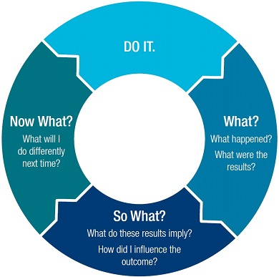
What? So What? What Now?
Notes:
Links, M. (2013). Refection on Reflection : Deep learning or medical narcissism ? RACP News. Retrieved from https://www.racp.edu.au/docs/default-source/resources/reflecting-on-reflection-deep-learning-or-medical-narcissism.pdf?sfvrsn=0

